Slide 1
Digital Inclusion
The necessity of accessibility
Notes:
Title might change

Slide 2
15% of the world has a disability.
Our research found these facts about the following types of disabilities.
Visual.
285 million people of all ages are visually impaired.
39 million are blind; 82% of all blind people are age 50 plus.
Hearing.
466 million people have disabling hearing loss.
By 2050, over 900 million people will have disabling hearing loss.
Cognitive.
Between 1 and 3% has an intellectual disability, as many as 200 million people.
Intellectual disability is significantly more common in low-income countries – 16.41 in every 1,000 people.
Speech.
Approximately 18.5 million people have a speech, voice or language disorder.

Slide 3
People with disabilities are regularly consuming all forms of content.
We conducted a study posing the question, “How often do you read, view, or listen to the following?”
1.
Visual
content.
Social Media:
89%.
TV Shows:
86%.
Short Videos:
80%.
Movies:
75%.
Social Media:
67%.
Music Videos:
65%.
2.
Non-visual content.
Radio:
74%.
Online Articles:
70%.
Informational & Educational:
65%.
Books:
58%.
Newspapers:
52%.
Podcasts:
48%..

Slide 4
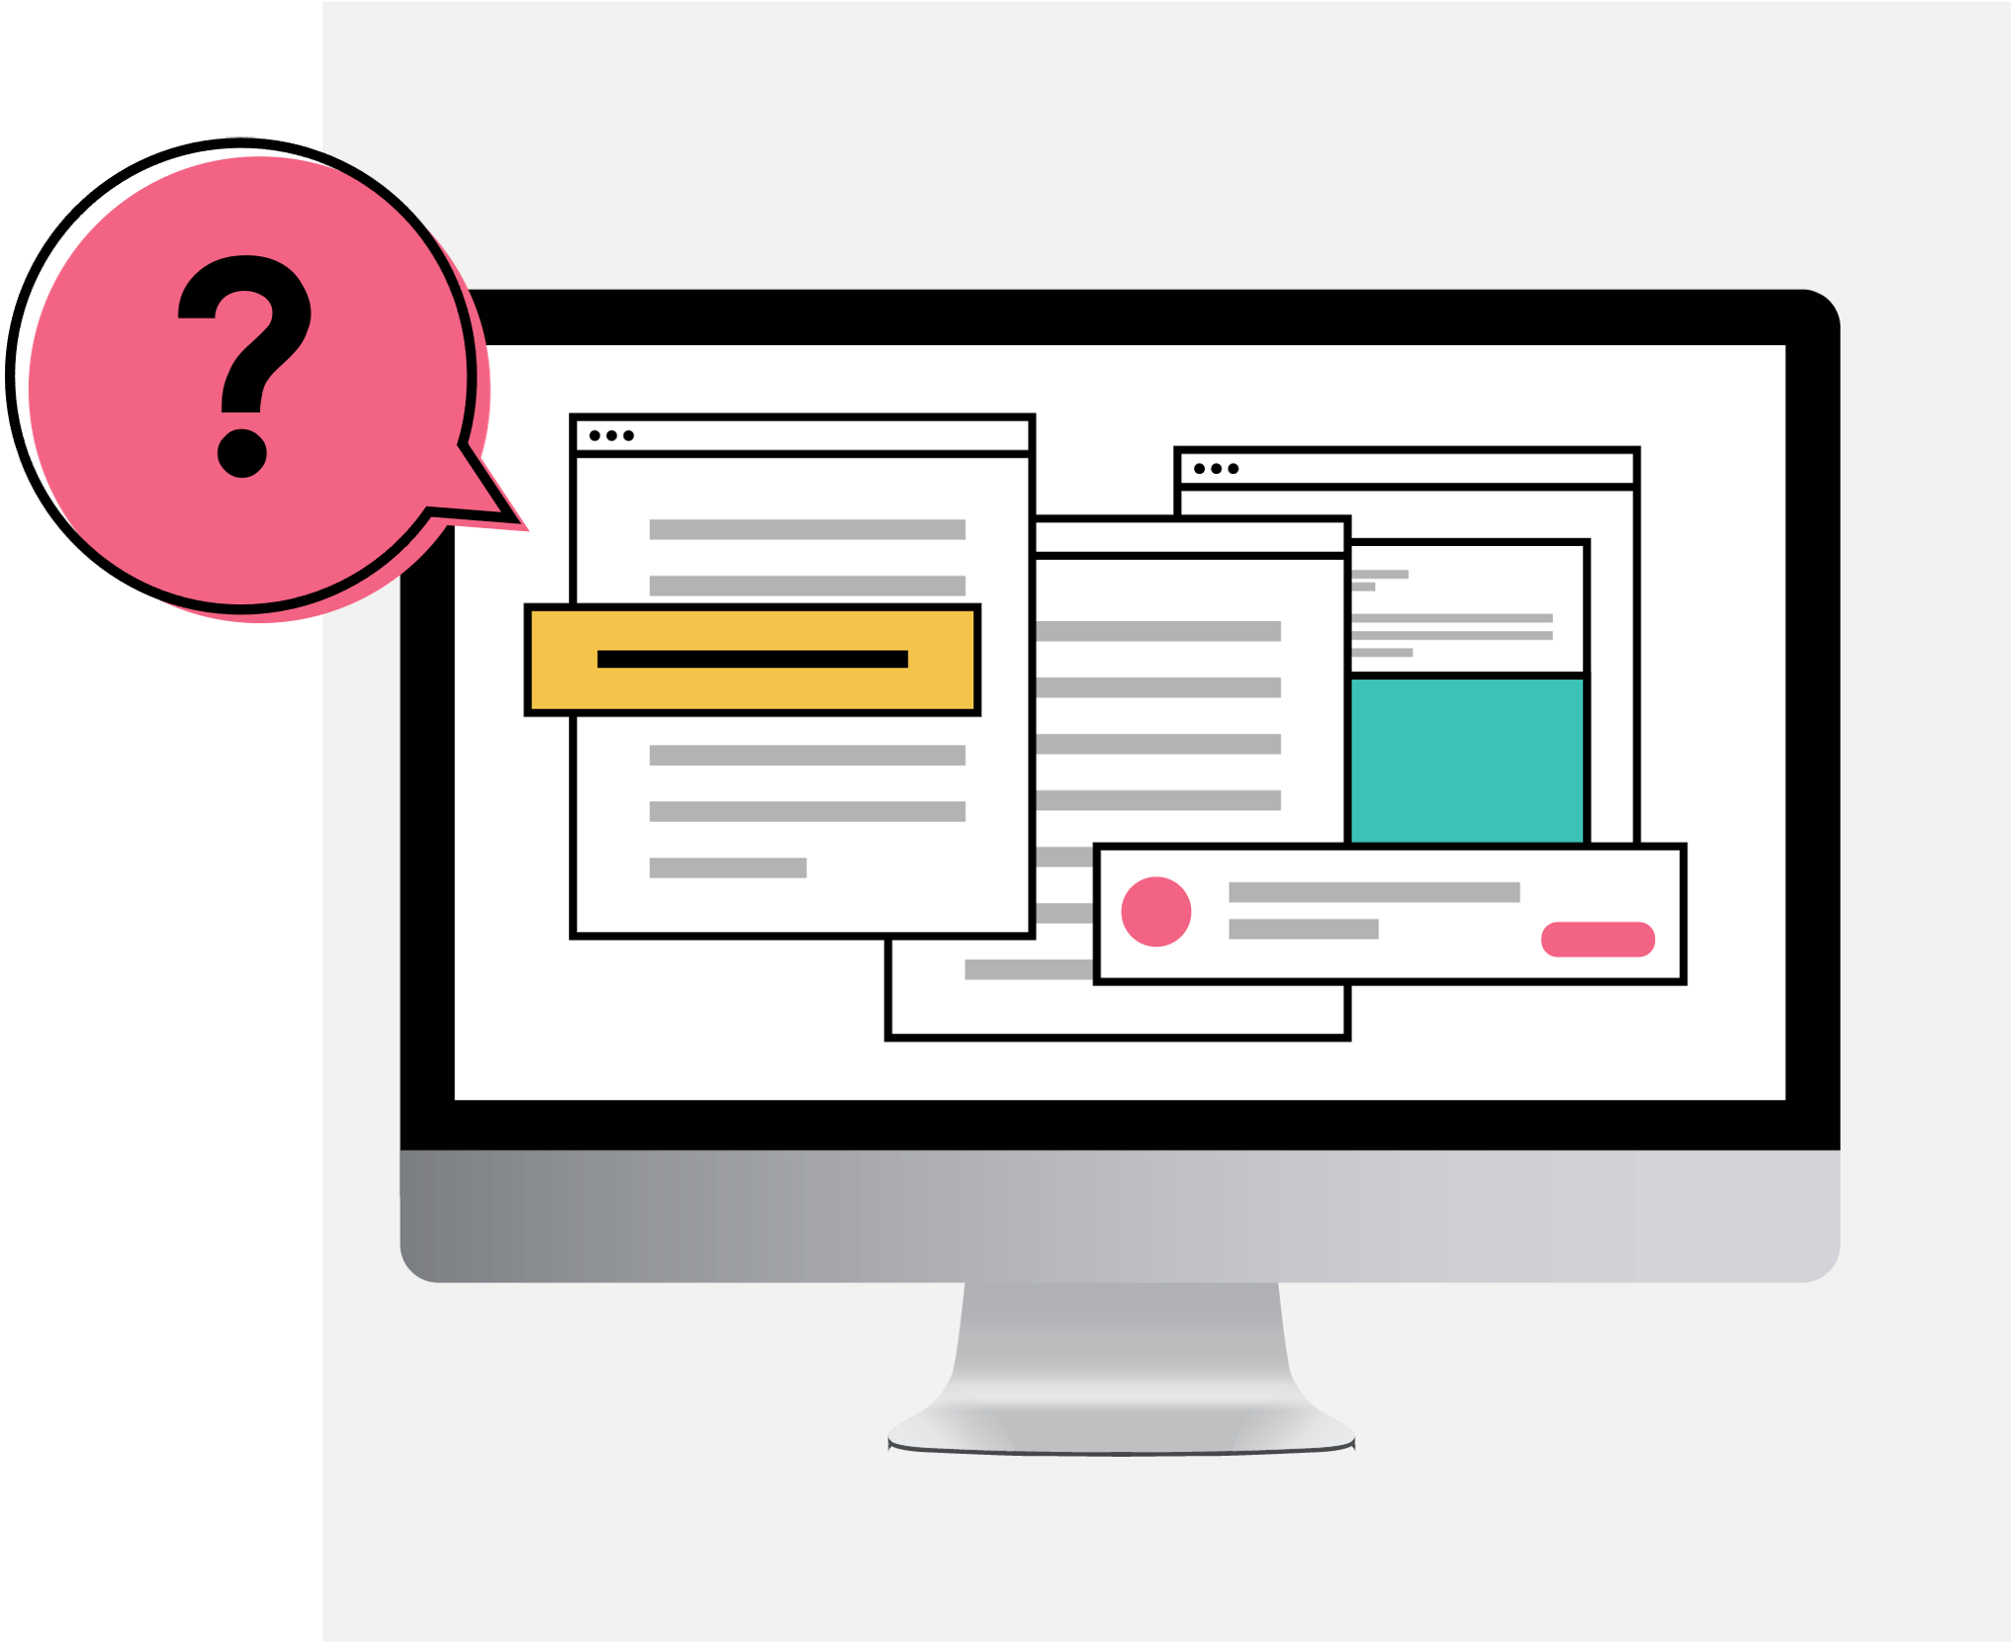
But can they actually access this content?

Slide 5
Methodology.
1. Participants:
We recruited participants with visual, hearing, cognitive, or speech disabilities.
2. Online Interviews:
We ran a survey to uncover…
Media consumption habits.
Point-of-view on communication from companies today.
These participants included U.K. and U.S. residents:
United Kingdom: 206 adults, age 16 and above.
United States: 601 adults, age 16 and above.

Slide 6
Visual media for all.

Slide 7
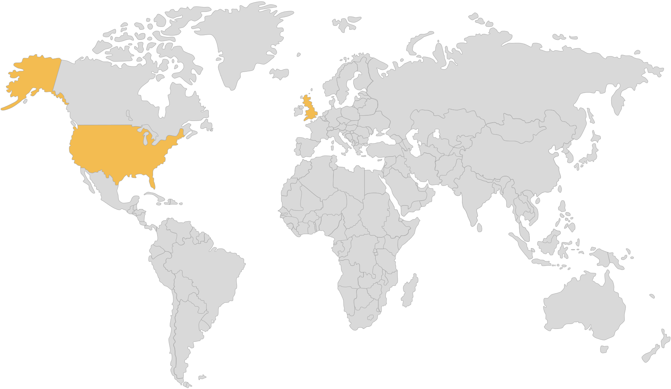
Despite having a disability, people are actively seeking out visual forms of content.
The following percentages of survey participants view visual content weekly or more often.
Includes people with visual, hearing, speech and cognitive disabilities.
United Kingdom: 98%
United States: 98%
U.S. number of participants = 601, U.K. number of participants = 206.
Question: How often do you view, read, or listen to the following?

Slide 8
In fact, even those with visual disabilities view a lot of visual content.
The following percentages of survey participants view visual content weekly or more often.
Only includes people with visual disabilities.
Non-visual.
96%
Visual.
98%
Especially Social Media, TV shows, and short video clips.
Visual content category break down:
Social Media — 89%.
TV Shows — 86%.
Short Video Clips — 82%.
Movies — 75%.
Music Videos — 74%.
Photographs — 68%.
People with visual disabilities, U.S. & U.K. number of participants = 480.
Question: How often do you view, read, or listen to the following?

Slide 9
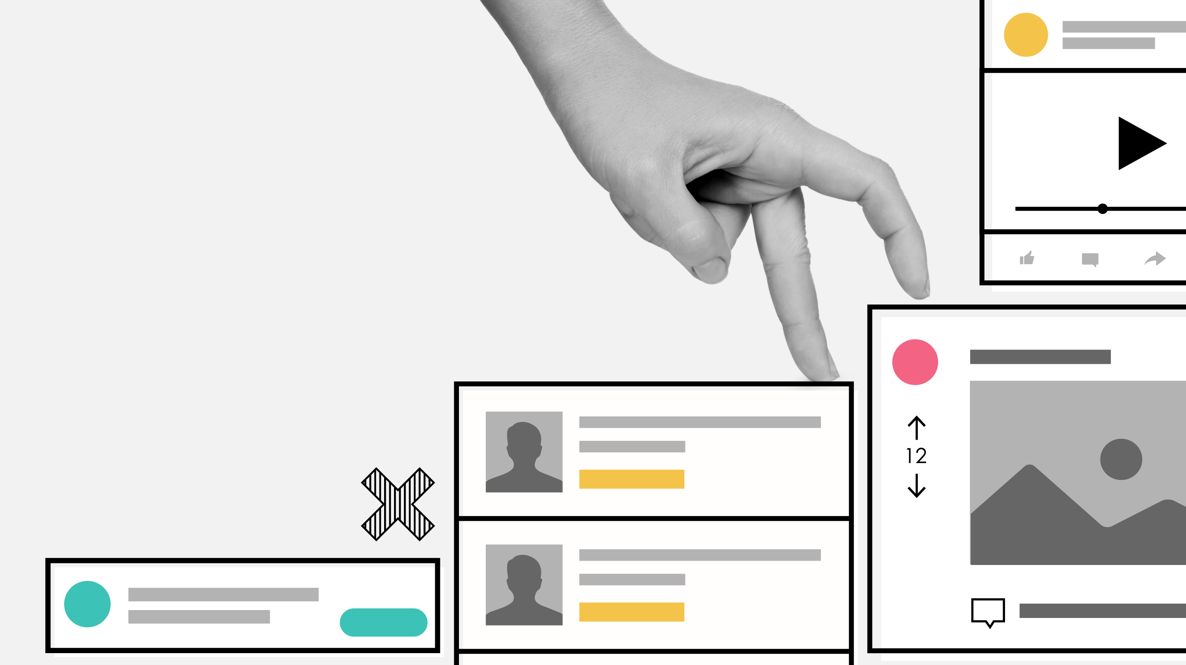
Social Media platforms are a challenge

Slide 10
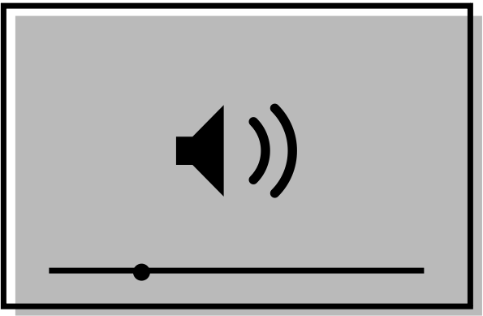
Social Media platforms are comparatively the most difficult to use.
The following percentage of participants said each platform is somewhat difficult, or very difficult to use.
Includes people with visual, hearing, speech and cognitive disabilities.
Social Media, 20%.
Particularly non-visual platforms such as Reddit, LinkedIn, and Twitter.
Web Browsers, 12%.
Audio Streaming, 11%.
Video Streaming, 9%.
People with visual disabilities, U.S. & U.K. number of participants = 480.
Question: How often do you view, read, or listen to the following?

Slide 11
No matter the type of disability, people struggle with social media.
The following percentage of participants said each platform is somewhat difficult, or very difficult to use.
Includes people with visual, hearing, speech and cognitive disabilities.
Results by disability type:
Visual disability:
Social media, 22%.
Web browsers, 11%
Audio Streaming 11%,
Video Streaming, 8%.
Hearing disability:
Social media, 17%.
Web browsers, 11%
Audio Streaming 9%,
Video Streaming, 11%.
Cognitive disability:
Social media, 23%.
Web browsers, 14%
Audio Streaming 13%,
Video Streaming, 13%.
Speech disability:
Social media, 27%.
Web browsers, 20%
Audio Streaming 20%,
Video Streaming, 17%.
U.S. & U.K. number of participants = 807.
Question: Thinking about the ways you consume your favorite content, what best describes your experience with using the following platforms and services?

Slide 12
Social media platforms simply lack accessibility.
In an open-ended question, participants gave these reasons why Social Media platforms are difficult to use.
Includes people with visual, hearing, speech and cognitive disabilities.
“A lot of small text and misleading buttons.”
“Ads interfere with actual posts.”
“Far too many options and menus.”
“hard to navigate, confusing.”
“Instagram especially is difficult to understand I don't see what I post and I rarely see what I am looking for.”
“Complicated with lots of links and words. Very busy everywhere and tabs not labeled well.”
U.S. & U.K. number of participants = 638.
Question: You indicated you have difficulty with the following categories. Can you tell us about some issues you have?

Slide 13
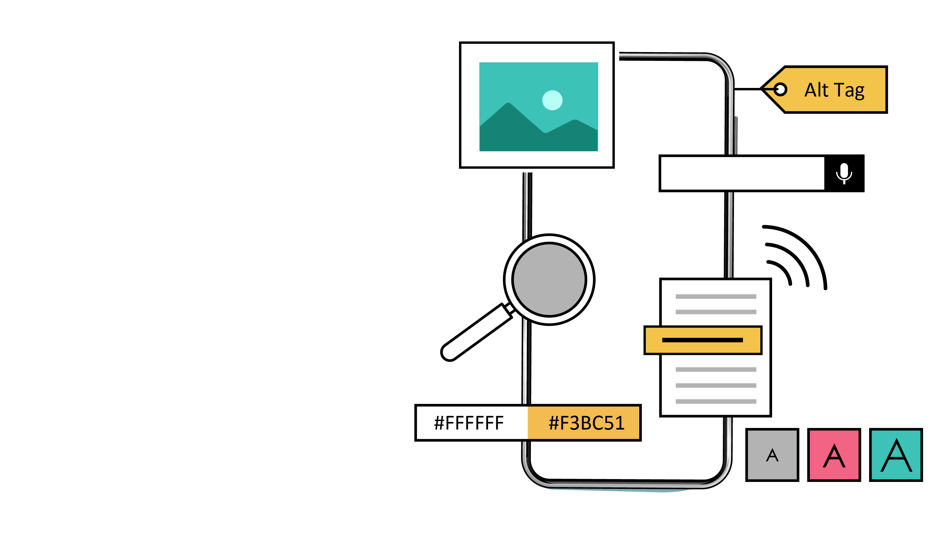
Assistive tools, a flawed necessity

Slide 14
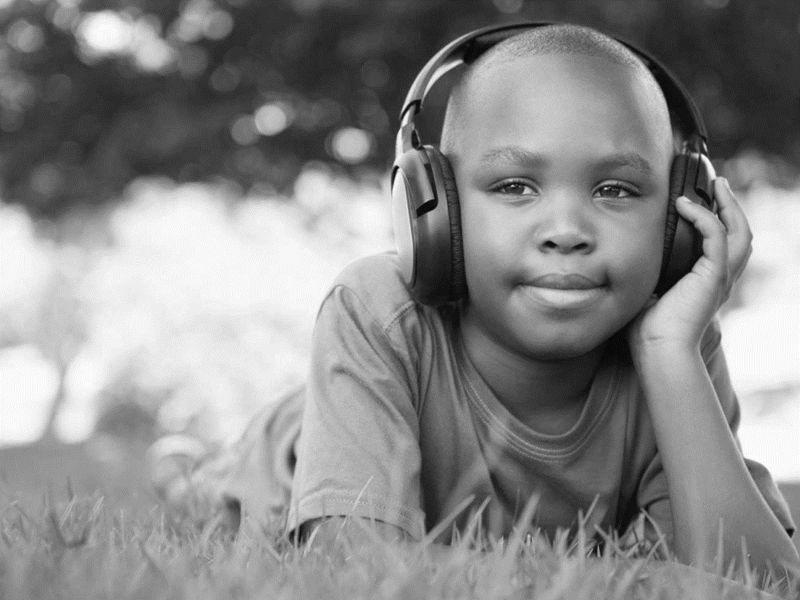
Over half use some type of assistive tool to consume media.
Participants answered the following about assistive tool usage.
Includes people with visual, hearing, speech and cognitive disabilities.
54%
Use an assistive tool to help read, view, or listen to content
46%
Either don’t or are not sure if they use an assistive tool
U.S. & U.K. number of participants = 807.
Question: Do you use any assistive tools to help you read, view, or listen to content?

Slide 15
The need for assistive tools isn’t restricted to a certain disability.
Assistive tool usage by disability| % Selected.
Includes people with visual, hearing, speech and cognitive disabilities.
Visual:
57%
Hearing:
56%
Speech:
79%
Cognitive:
64%
People with speech and cognitive disabilities, in particular use assistive tools.
Those who use an assistive tool, U.S. & U.K. number of participants = 436.
Question: Do you use any assistive tools to help you read, view, or listen to content?

Slide 16
People have problems consuming content even with an assistive tool.
Content consumption with an assistive tool | % Selected.
Includes people with visual, hearing, speech and cognitive disabilities.
64%
Reported having problems consuming content even with an assistive tool.
34% had problems consuming content because of the tool.
30%
had problems consuming content because of the content.
Brands have an opportunity to help directly.
Those who use an assistive tool, U.S. & U.K. number of participants = 436.
Question: Have you ever had problems viewing, reading, or listening to content online even with an assistive tool(s)?

Slide 17
Basic challenges with assistive tools affect basic functioning.
Reasons why people have issues consuming content even with an assistive tool | Open-ended responses.
Includes people with visual, hearing, speech and cognitive disabilities.
“Had readability issues with the tool.”
“My glasses are too old.”
“Trouble understanding how the tool works.”
“Words were still blurry.”
“Could not understand what was being said because closed captions would not keep up.”
Had problems consuming content even with an assistive tool, U.S. & U.K. number of participants = 280.
Question: Have you ever had problems viewing, reading, or listening to content online even with an assistive tool(s)?

Slide 18
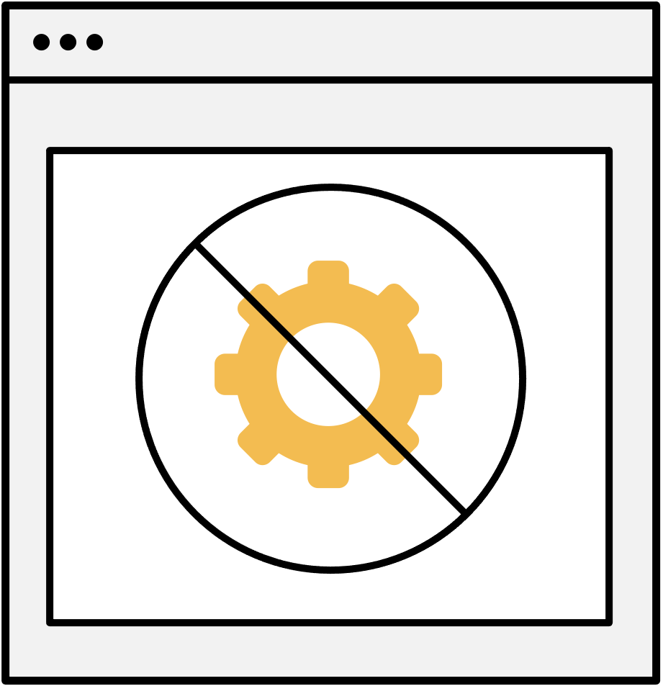
And many don’t even have access to assistive tools.
Reasons why people need, yet don’t use assistive tools | % Selected.
Includes people with visual, hearing, speech and cognitive disabilities.
37% say they are too expensive.
35% say they don’t find assistive tools useful.
22% say assistive tools are inconvenient to setup.
6% have other reasons.
Don’t use an assistive tool, U.S. & U.K. number of participants = 339.
Question: Why don’t you use an assistive tool(s)?

Slide 19
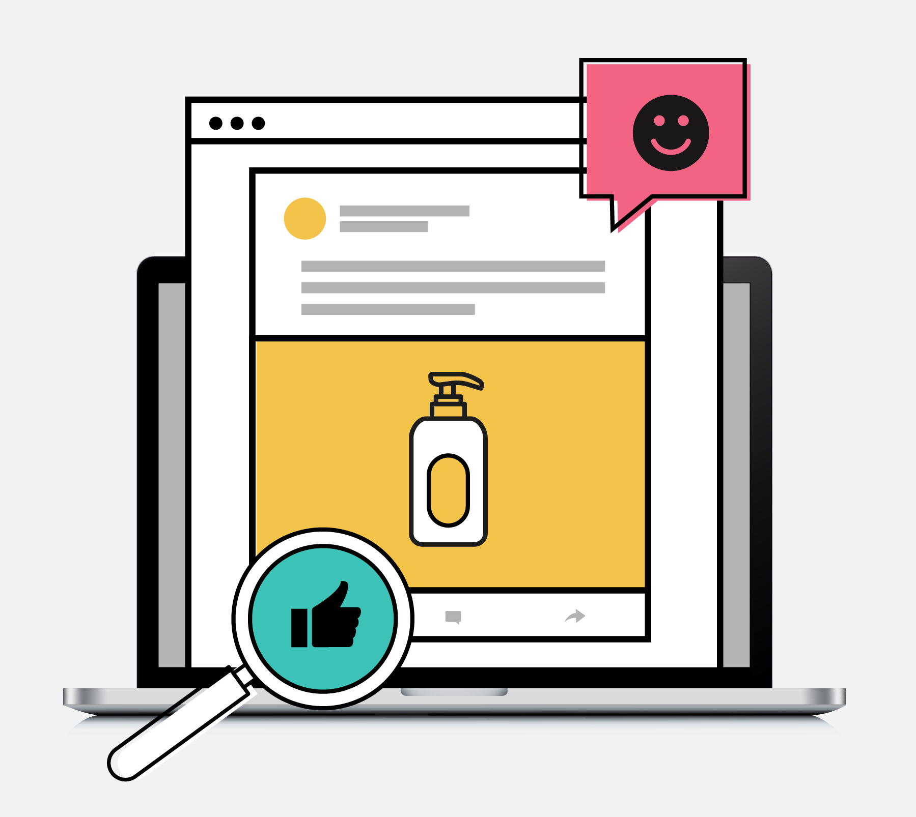
Why is accessible communication important for brands?

Slide 20
Brands are doing a good job, but expectations might be low.
40%
Good.
Brand scorecard on accessibility | % Selected.
Includes people with visual, hearing, speech and cognitive disabilities.
37%
Excellent.
20%
Fair.
2%
Not Good.
1%
Terrible.
No differences by type of disability.
U.S. & U.K. number of participants = 807.
Question: In general, how well do you think companies are doing with communicating in a way that is accessible for all?

Slide 21
In the minds of consumers, standards for brand accessibility are low to begin with.
Changes companies should make | Open-ended responses.
Includes people with visual, hearing, speech and cognitive disabilities.
“I don’t know”
“I don’t think I would change anything”
“I don’t really know to be honest”
“I dunno”
“I really don’t know I wish I had an idea”
U.S. & U.K. number of participants = 807.
Question: If you could make any change to the way companies are currently communicating with you, what would it be?

Slide 22
Younger folks expect more from brands.
Brand scorecard on accessibility– Excellent or good job | % Selected.
Includes people with visual, hearing, speech and cognitive disabilities.
People 18 to 24:
.70%
People 25 and over:
.79%
U.S. & U.K. Those who said brands are doing an excellent or good job number of participants = 622.
Question: In general, how well do you think companies are doing with communicating in a way that is accessible for all?

Slide 23
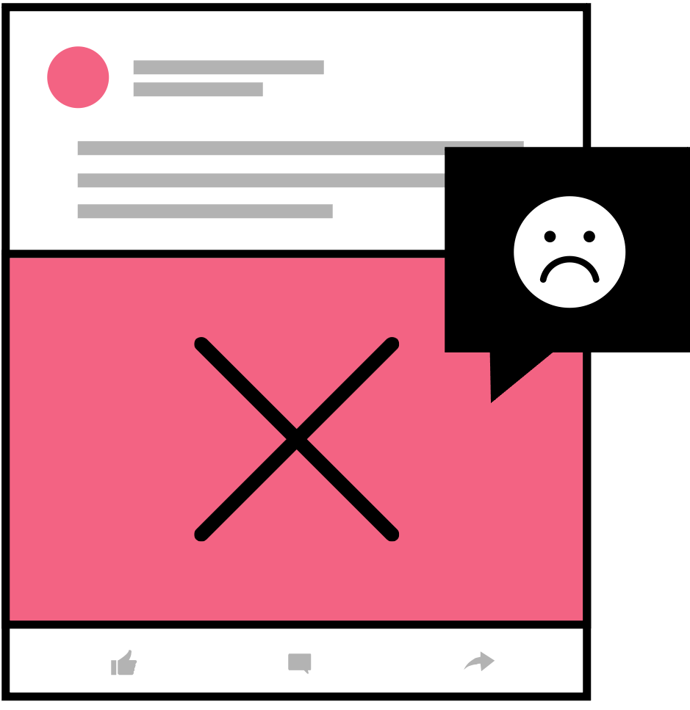
Lack of brand accessibility leads to feelings of frustration.
People’s feelings when communication from brands is not accessible | % Selected.
Includes people with visual, hearing, speech and cognitive disabilities.
Isolated.
17%.
Unhappy
21%.
Ignored.
27%.
Disappointed.
31%.
Frustrated.
38%.
U.S. & U.K. number of participants = 807.
Question: How does it make you feel when companies don’t communicate in a thoughtful manner that is accessible for everyone?

Slide 24
Inaccessible communications can have serious repercussions for brands.
People’s feelings about brands when communication is not accessible | % Net Score.
Includes people with visual, hearing, speech and cognitive disabilities.
Negative actions towards the brands:
40%.
Wouldn’t purchase from the brand.
Wouldn’t recommend the brand to others.
Negative emotional response:
81%.
Feel disconnected from the brand.
Feel less excited about the brand.
Feel like the brand lacks positive qualities.
Feel like the brand is unreliable.
U.S. & U.K. number of participants = 807.
Question: How would you feel about companies that do not communicate in a thoughtful manner that is accessible for everyone?

Slide 25
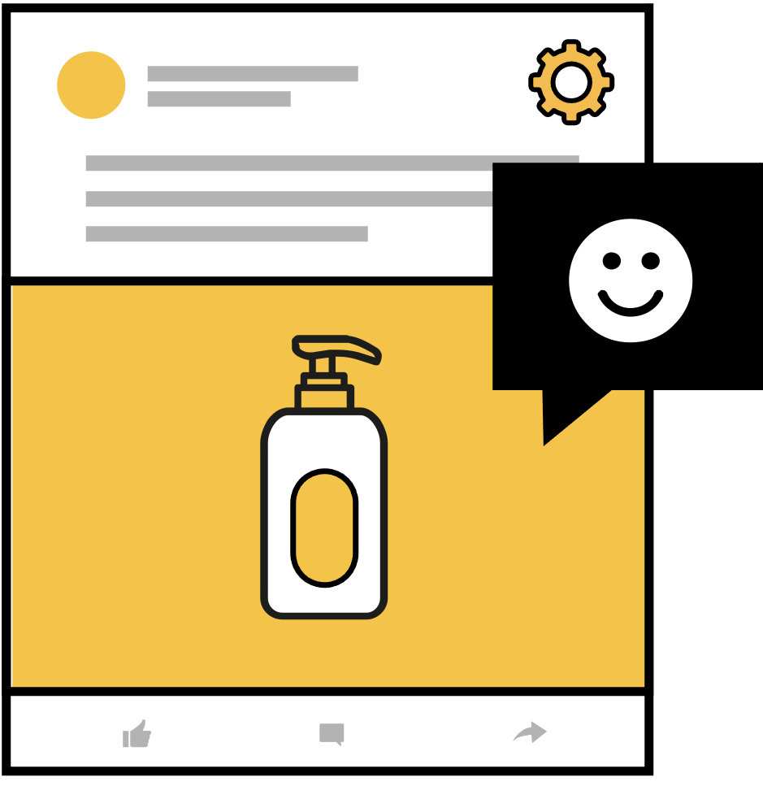
When brands are accessible, they reap a host of benefits.
People’s feeling about brands when communication is accessible | % Net Score.
Includes people with visual, hearing, speech and cognitive disabilities.
Positive actions towards the brands:
60%.
Would choose them over other brands.
Would recommend them to others.
Positive emotional response:
81%.
Feel connected to the brand.
Feel like the brand cares about my needs.
Feel excited about the brand.
Feel like the brand is reliable.
U.S. & U.K. number of participants = 807.
Question: How would you feel about companies that do not communicate in a thoughtful manner that is accessible for everyone?

Slide 26
…and spark positive emotions.
People’s feelings when communication is accessible | % Selected
Includes people with visual, hearing, speech and cognitive disabilities.
Relieved
28%.
Included
36%.
Happy
41%.
Supported
45%.
Satisfied
49%.
U.S. & U.K. number of participants = 807.
Question: How does it make you feel when companies do communicate in a thoughtful manner that is accessible for everyone?

Slide 27
To connect with people, brands need to put in the work to make communications accessible.

Slide 28
Implications:
1.
2.
3.
Brands should not overlook accessibility when it comes to communications. People with all types of disabilities consume a lot of media and the majority have trouble.
Assistive tools are only part of the solution. Hearing the lived experiences of people with disabilities clearly shows assistive tools don’t always work, with the content itself being half the problem.
Accessibility in planning communication is not simply a “nice to have”, it’s a must. It has a direct impact on how people feel in general and about your brand.

Slide 29
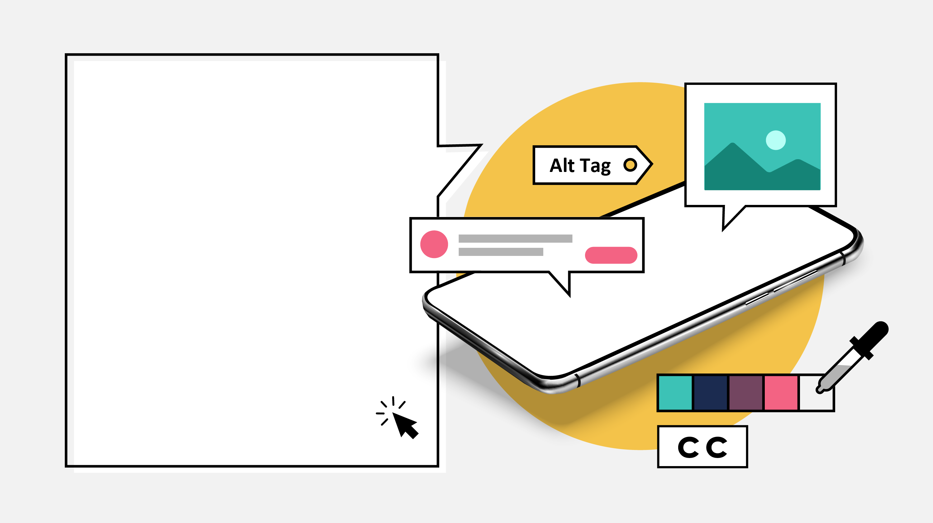
Thank You.

